Slide 1
(a)
Notes:
Figure 1. Pearl River Estuary and 1-3D coupled hydrodynamic model: (a) the Pearl River Delta with the Pearl River network and the Pearl River Estuary

Slide 2
(b)
Notes:
Figure 1. Pearl River Estuary and 1-3D coupled hydrodynamic model: (b) the computational cross-sections for the 1D river network model

Slide 3
(c)
Notes:
Figure 1. Pearl River Estuary and 1-3D coupled hydrodynamic model: (c) the model grid for the 3D estuary model.

Slide 4
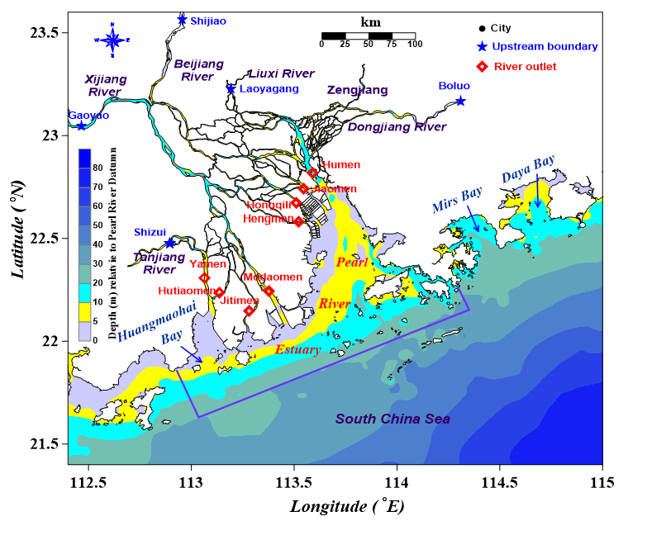
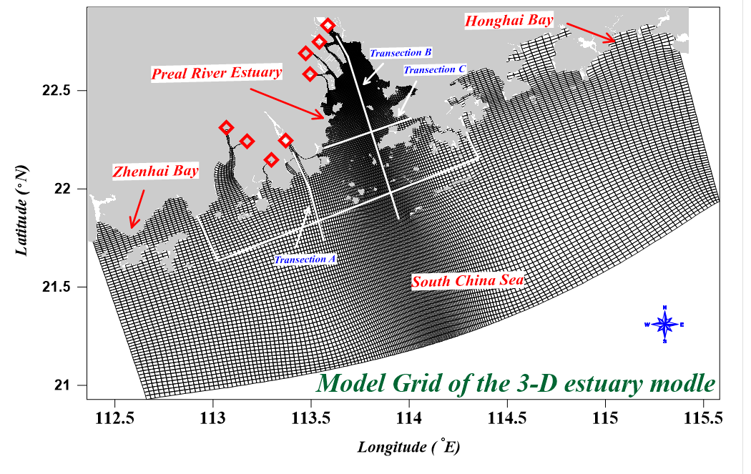
(a)
(b)
(c)
Notes:
Figure 1. Pearl River Estuary and 1-3D coupled hydrodynamic model: (a) the Pearl River Delta with the Pearl River network and the Pearl River Estuary, (b) the computational cross-sections for the 1D river network model, and (c) the model grid for the 3D estuary model.

Slide 5
Notes:
Figure 1. Pearl River Estuary and 1-3D coupled hydrodynamic model: (c) the model grid for the 3D estuary model.

